Slide 1

Bay Inn
Group 8
Saadman Ahmed Saad 011 161 205
Faria Rakib Borsha 011 191 106
Anon Sarkar 011 191 170
Ananna Ghosh 011 191 268
Jannatul Ferdous 011 192 017

Slide 2
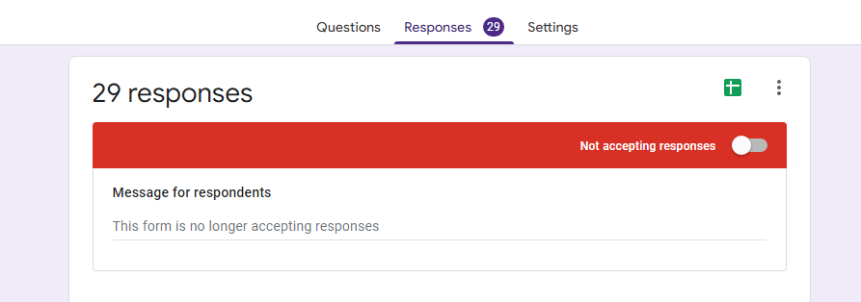
Information Gathering
We’ve tried to gather information through social media platforms. Such as Facebook, Messenger, WhatsApp etc.
There were 29 responses. We’ve fixed the final feature list based on these responses.

Slide 3
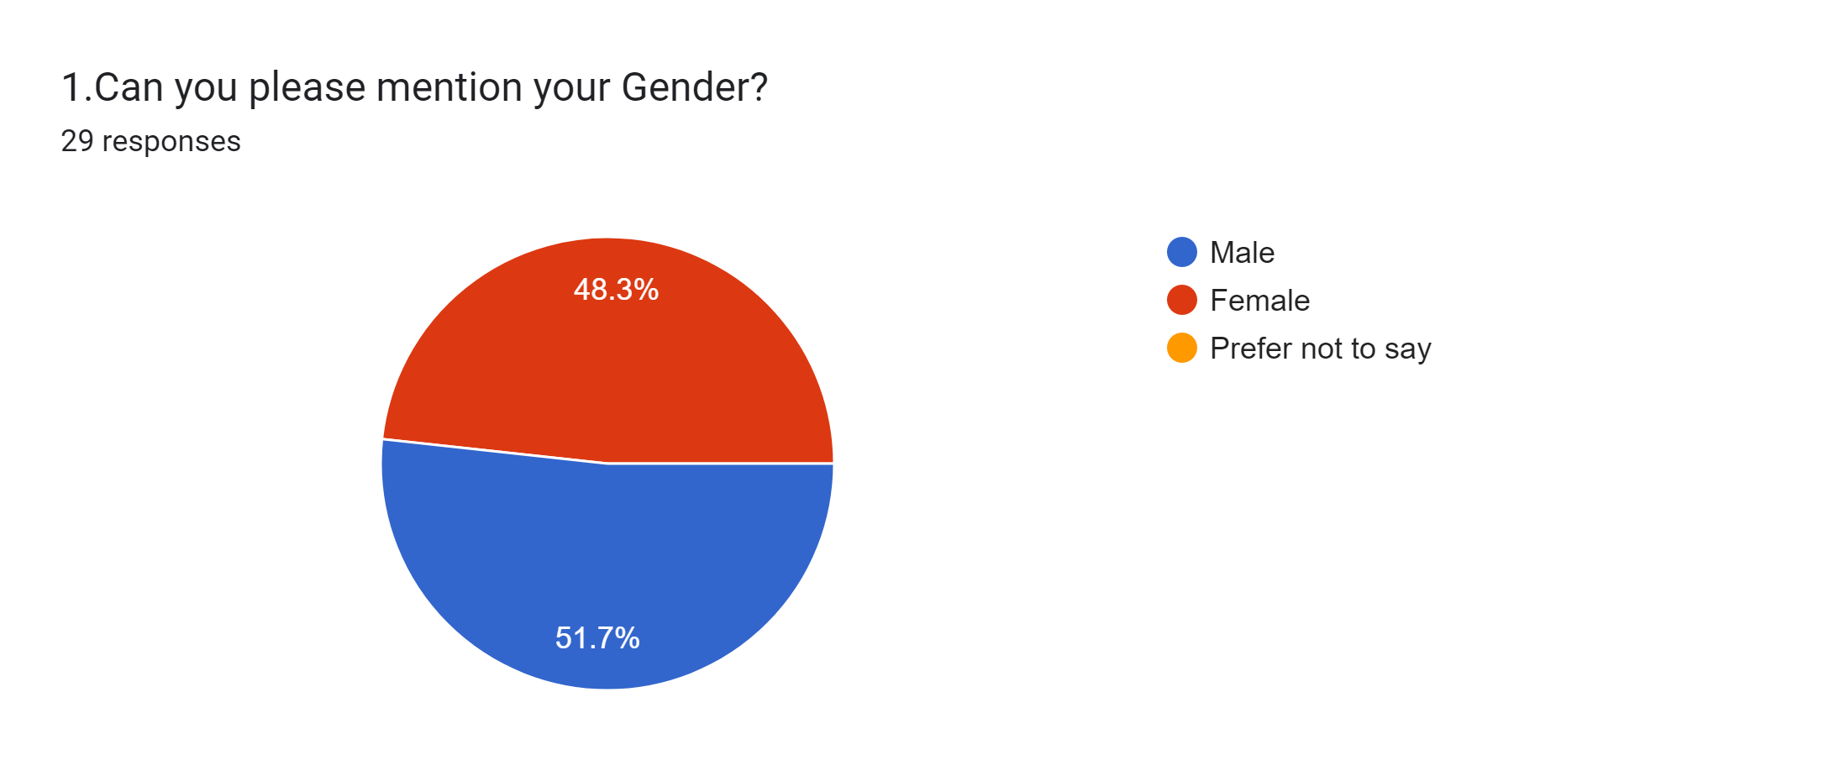
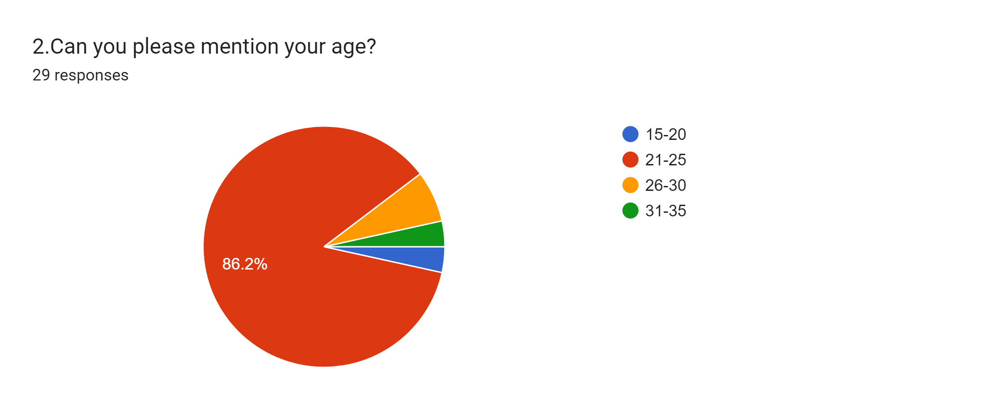
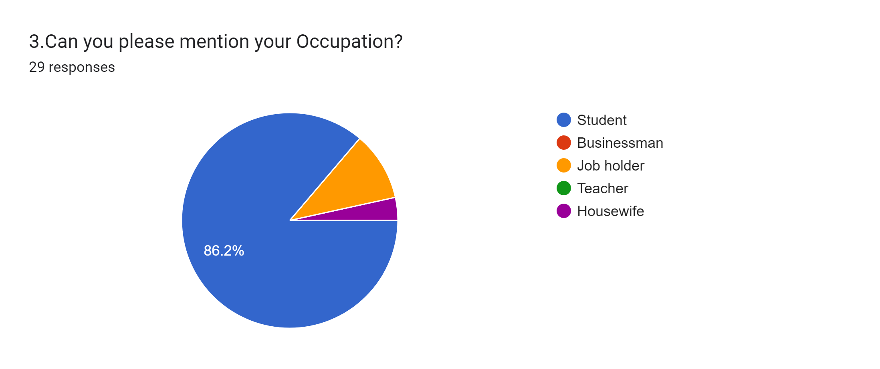
There were almost equal ratio of male and female. We couldn’t distinguish between which gender is more active in booking hotels through online or offline.
We can say that most of the respondent are of age group 21-25.
Most of the response were from students. From this we can say that we should focus more on the youth group.

Slide 4
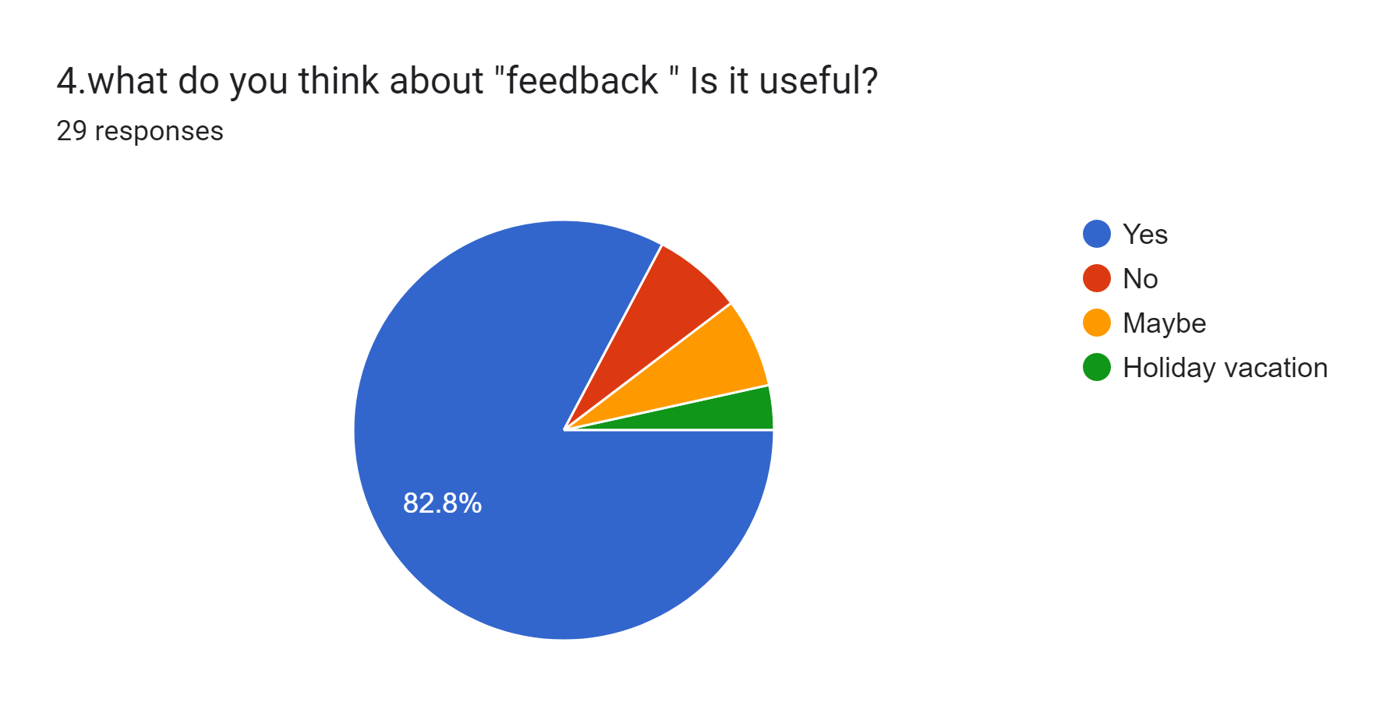
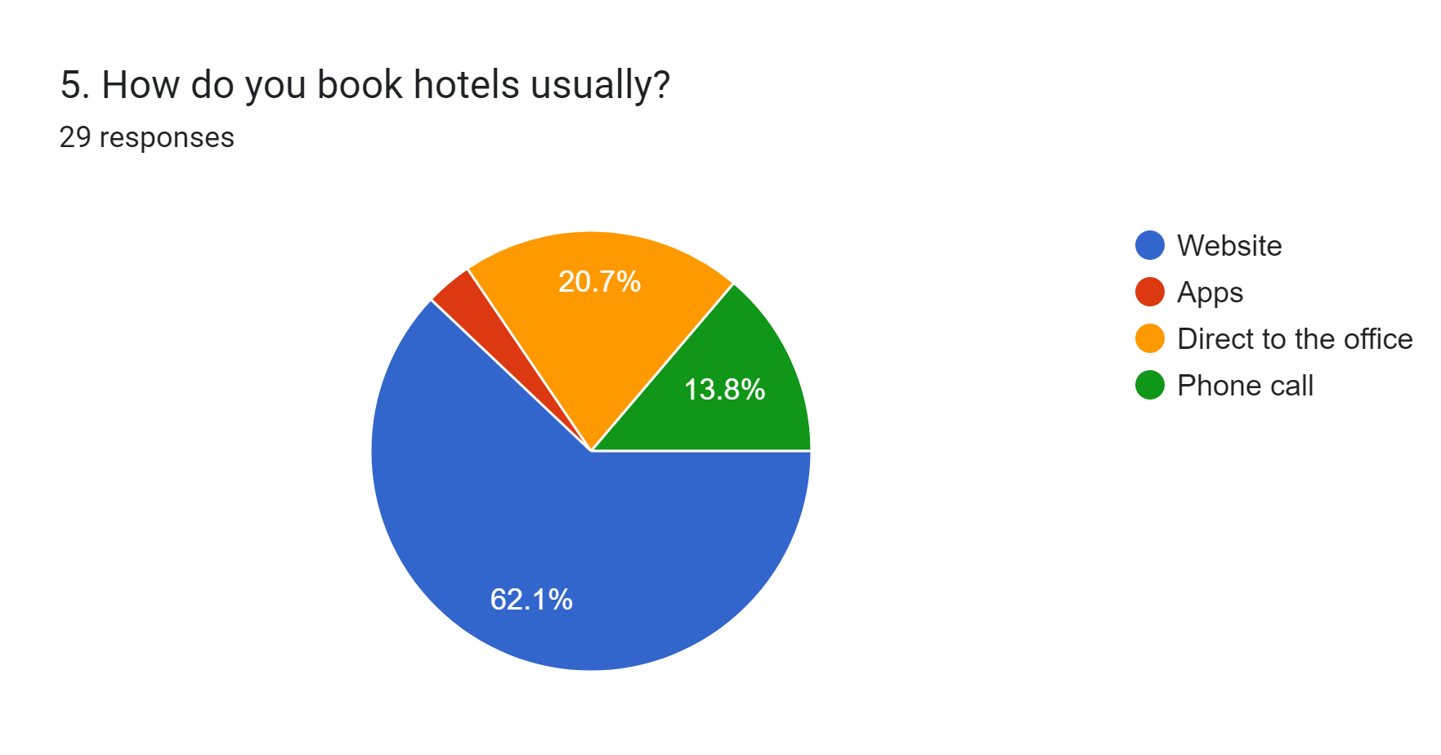
The feature “Feedback” was one of the features that we chose to keep. As we can see 82.8% respondents find it useful.
62.1% respondents books hotels through websites. Which is a positive thing for our website.

Slide 5
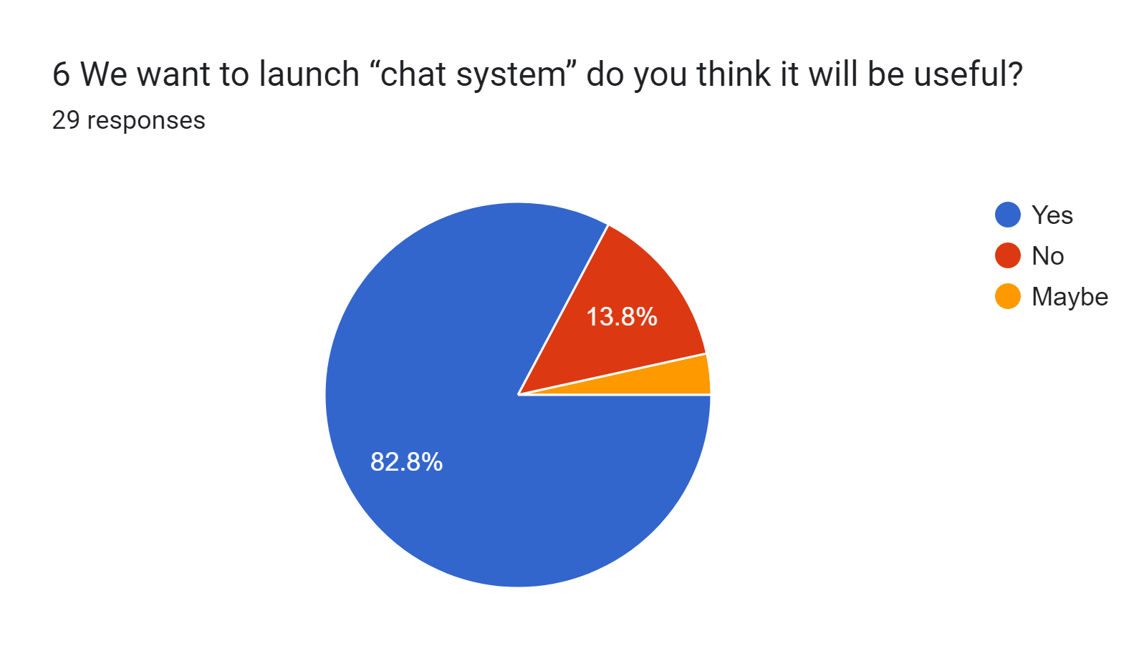
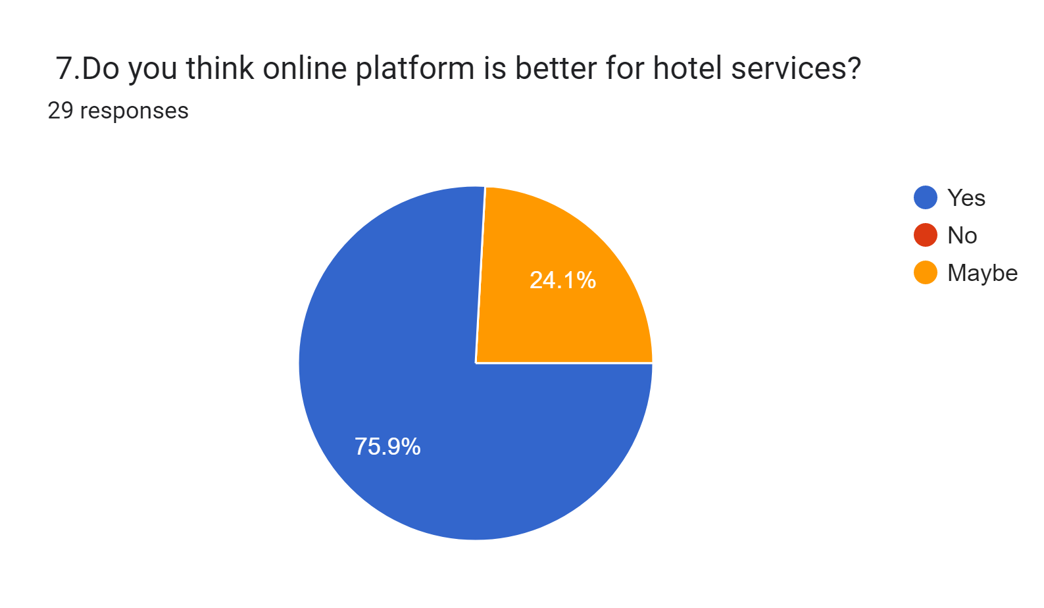
A huge group on respondents wanted the feature “Chat system”. Which isn’t present in our current feature list.
Online platform is definitely better for booking hotel services as it has a confirmation. And 75.9% respondents agrees.

Slide 6
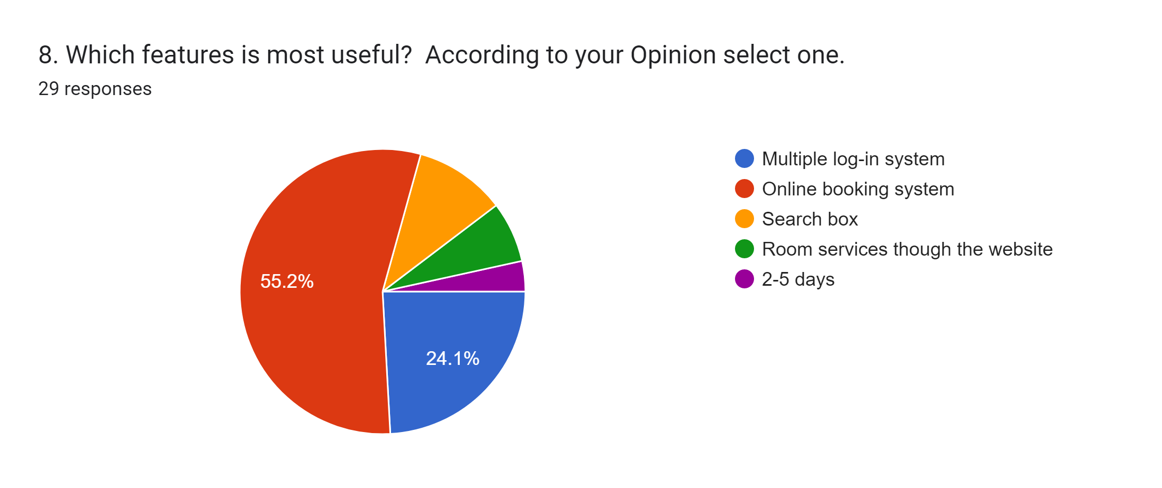
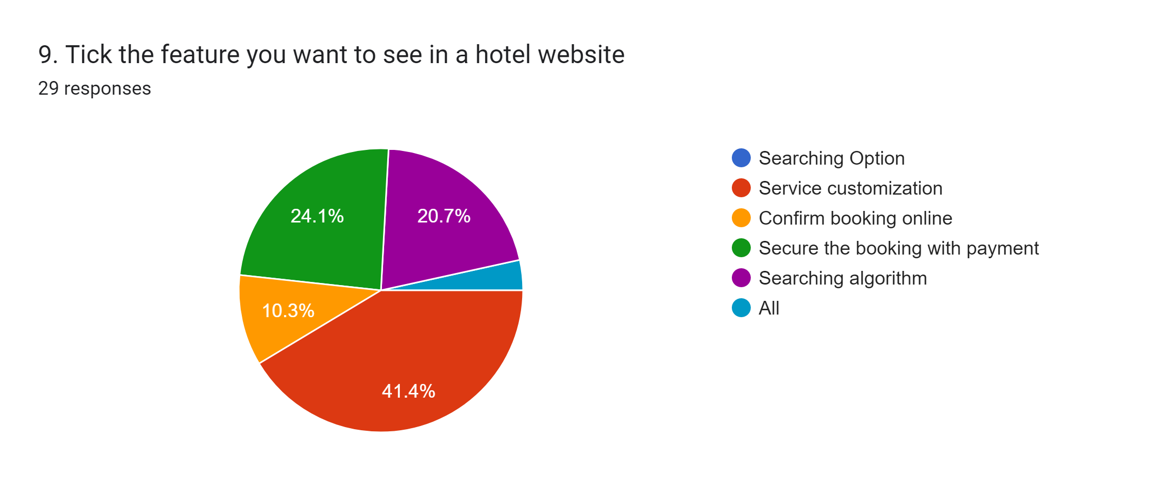

According to 55.2% of our respondents “Online booking system” is the most useful feature among other mentioned features. The 2nd most useful feature is “Multiple log-in system”.
41.4% respondents wants to see customized services. The 2nd and 3rd most wanted feature is secured payment system after booking and searching option with 24.1% and 20.7% response.
option

Slide 7
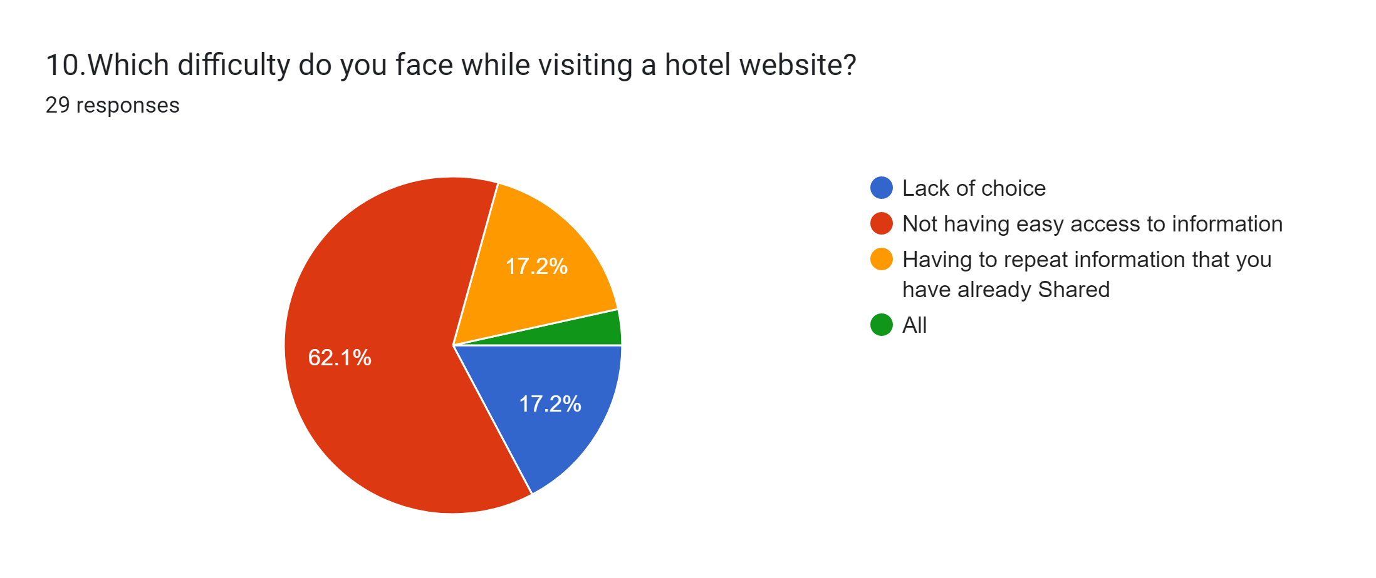
62.1% respondents find it difficult that hotel websites doesn’t have easy access to information which isn’t user friendly at all. Lack of choice and having to repeat information in a website is the 2nd most problem that respondents find difficult.

Slide 8
Feasible & Discarded Features
Before Survey | After Survey
Multiple log-in system | ✓
Admin panel | ✓
Search box | ✓
Online booking system | ✓
Online payment system | ✓
Room services through website | ✓
Feedback box | ✓
Complain box | ✓
FAQ section | ✓
✗ | Chat System

Slide 9
SWOT Analysis
Strength: 82.8% and 55.2% respondents chose the features “Feedback section” and “Online booking system”. 62.1% respondents book their hotel through “Websites” and 75.9% respondents think “Online platform” for hotel services is better. These are definitely our strength.
Weakness: 82.8% people thinks “Chat system” is useful but we haven’t add this feature in our project. So this could be our weakness.
Opportunity: A huge group of respondents were students and of age group 21-25. This group of people are an opportunity for us. As this is the majority group who uses online platform. This is an opportunity for our website.
Threat: 37.9% of people uses other ways to book hotels instead of using website. 62.1% face the difficulty of not having easy access to information. These are the threats we should keep an eye out for.

Slide 10
Strength | Weakness | Opportunity | Threats
Feedback section | Chat system | People of age group 21-25 | Making easy access to information
Online booking system |  | Students | People who don’t use online platforms
Online platform
Strategy
Based on the SWOT analysis we’ve come up with some strategies that we need to follow:
Consider adding chat system in our website.
Target the youth and students. Specially on holidays or vacations.
Try to make the website user friendly where the user can have all the information they need.
Try to make the website learnable so that the people who don’t use online platform, they can also use our website.

Slide 11

Any questions?

